Slide 1
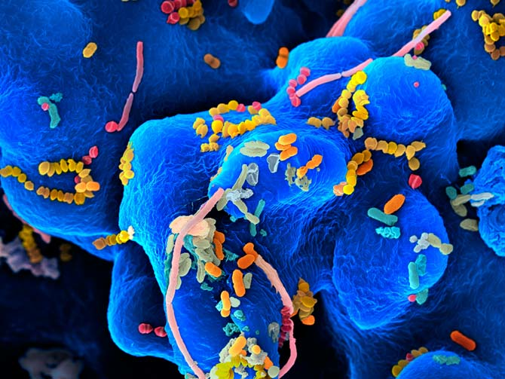
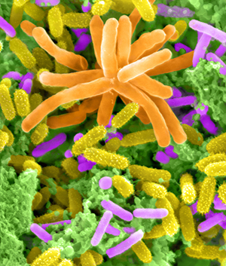
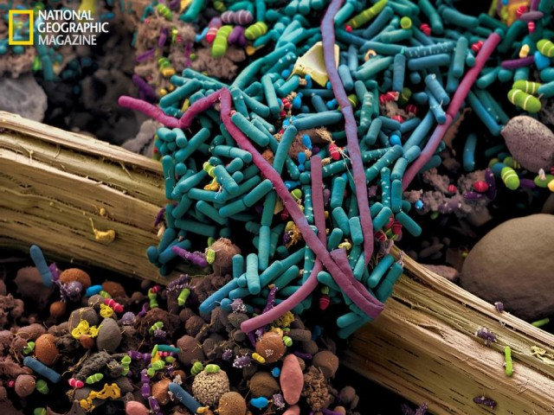
Models of microbial communities: diversity & functioning

Slide 2
Microbial communities provide many ecosystem services:
Decomposition
Carbon and nitrogen cycling
Waste water treatment
Bioremediation: pollution, oil spills
(Rivers et al. 2013 ISME Journal. 11:789)
Nutrients for plant roots, exclude pathogens
(Philippot et al. 2013 Nat. Rev. Microb. 7:2315)
and disservices:
Disease
metabolic function
Notes:
Role in digestion, protection from disease
How does complex system respond to change in conditions?
Fascinating system, currently descriptive and speculation

Slide 3
Human gut:
10¹⁵ bacteria, thousand species, many unculturable
(highest density in colon - anaerobes)
Invasion: pathogens or probiotics?
Homeostasis to maintain function
Fitness and inheritance
A separate organ
Notes:
Role in digestion, protection from disease
How does complex system respond to change in conditions?
Fascinating system, currently descriptive and speculation

Slide 4
Human gut:
Diversity (next generation sequencing)
Function: nutrition; protection
Dynamics: effects of antibiotics
Management: pre- and pro-biotics
Evolution? Models versus experiments
Robinson et al. 2010. From structure to function: the ecology of host-associated microbial communities. Microb. Mol. Biol. Rev. 74: 453-476
Notes:
Role in digestion, protection from disease
How does complex system respond to change in conditions?
Fascinating system, currently descriptive and speculation

Slide 5
Human gut: diversity
Most bacteria are unculturable
Only discovered existence using 16S rRNA sequences
Recent studies can sample millions of sequences
Notes:
Role in digestion, protection from disease
How does complex system respond to change in conditions?
Fascinating system, currently descriptive and speculation

Slide 6
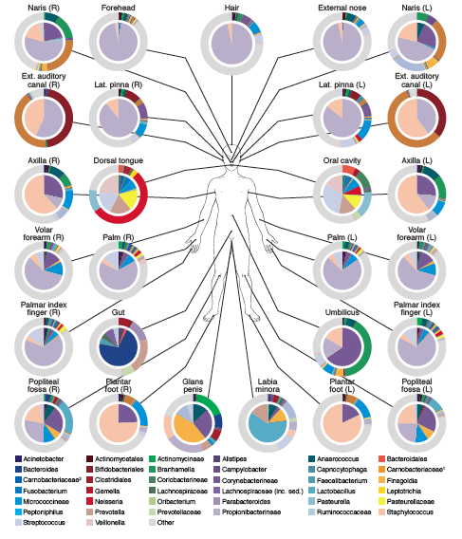
Costello et al. 2009
Bacterial community variation in human body habitats. Science 326:1694
454 sequencing
>1,070,000 sequences of V2 region of 16S
Notes:
Role in digestion, protection from disease
How does complex system respond to change in conditions?
Fascinating system, currently descriptive and speculation

Slide 7
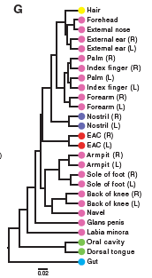
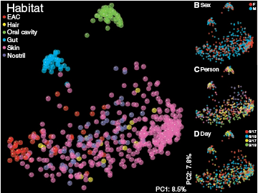
Costello et al. 2009
Description of diversity and patterns
Notes:
Role in digestion, protection from disease
How does complex system respond to change in conditions?
Fascinating system, currently descriptive and speculation

Slide 8
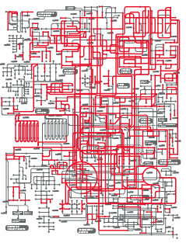
Qin et al. 2010
A human gut microbial gene catalogue.
Nature 464:59
576.7 Gb sequence
from 124 individuals
Inferred 3.3. million unique genes
Notes:
Role in digestion, protection from disease
How does complex system respond to change in conditions?
Fascinating system, currently descriptive and speculation

Slide 9
A human gut microbial gene catalogue.
General house-keeping genes
Genes for binding to host proteins (e.g. fibrinogen)
Biodegradation of complex sugars, e.g. pectin
Bacteria ferment sugars to short chain fatty acids
=> host uses them in muscle, heart, brain…
Function of different species?
Notes:
Role in digestion, protection from disease
How does complex system respond to change in conditions?
Fascinating system, currently descriptive and speculation

Slide 10
Sampling?
576.6 Gb from 124 individuals
= 4.65 Gb bases per community
If there were 1000 species, equal abundance, average of 4.65 Mb per species; ~ 1X coverage of genome
In fact, abundances are not even
Good for metabolic overview, poor for species sampling
Notes:
Role in digestion, protection from disease
How does complex system respond to change in conditions?
Fascinating system, currently descriptive and speculation

Slide 11
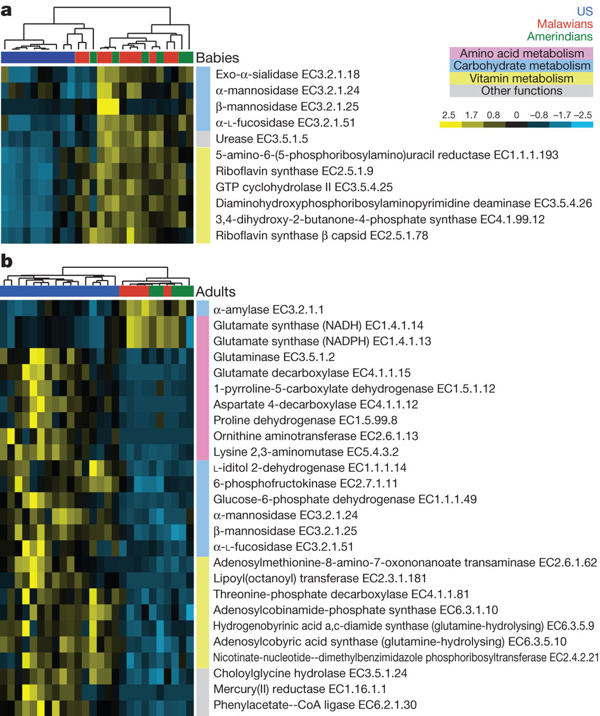
Case study: human
gut:
Differences in
abundance of
particular genes
e.g. more
riboflavin synthesis
in Malawi &
Amerindian babies
Yatsunenko et al. 2012. Human gut microbiome viewed across age and geography. Nature 486:222-227
Notes:
Role in digestion, protection from disease
How does complex system respond to change in conditions?
Fascinating system, currently descriptive and speculation

Slide 12
Human gut: function
Need ecology of component species or functional groups to model dynamics etc.
Bioinformatics to predict function from genomes
Direct evidence?
Notes:
Role in digestion, protection from disease
How does complex system respond to change in conditions?
Fascinating system, currently descriptive and speculation

Slide 13
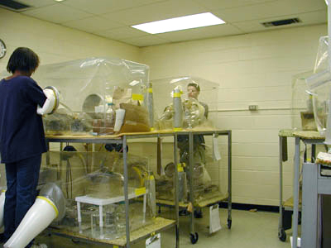
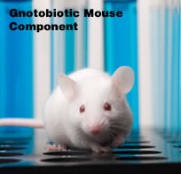
Function: gnotobiotic mice
Sterile mice born by cesarean section and maintained in controlled environments.
Notes:
Role in digestion, protection from disease
How does complex system respond to change in conditions?
Fascinating system, currently descriptive and speculation

Slide 14
Function: gnotobiotic mice
Protects against injury to gut wall; improves healing after injury to gut wall
Protects against invasion by pathogens
Aids energy extraction and storage
Important for development of healthy immune system
=> tends not to separate bacterial species, but could do so. Some differences to human system.
Notes:
Role in digestion, protection from disease
How does complex system respond to change in conditions?
Fascinating system, currently descriptive and speculation

Slide 15
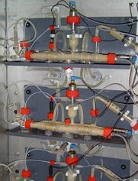
Function: chemical methods
Stable isotope probing (e.g. labeled starch or glucose)
Look for enrichment of heavy isotopes in 16S sequences to identify taxa using particular nutrients
e.g. Ruminoccoccus bromii
ferments starch to acetate
Eubacterium rectale
converts acetate to butyrate
Hard in vivo, use in vitro simulators
TIM-2 human gut simulator
Notes:
Role in digestion, protection from disease
How does complex system respond to change in conditions?
Fascinating system, currently descriptive and speculation

Slide 16
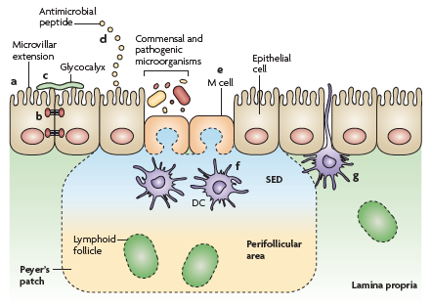
Function: immune system
Gut walls rich in
immune cells
Special cells for
sampling intestine
Inflammation; secrete
broad-range
antimicrobial peptides
Feedback loop with
Short-chain fatty acids (inhibit inflammatory response)
Commensals stimulate proper development of immune system
Immune system can influence community of commensals
Artis 2008. Nat. Rev. Immun. 8:411
Notes:
Role in digestion, protection from disease
How does complex system respond to change in conditions?
Fascinating system, currently descriptive and speculation

Slide 17
Human gut: dynamics
Community composition variable through time and among individuals.
Succession in juveniles
Antibiotics reduce total bacterial counts and especially some taxa (depending on antibiotic)
Diet affects composition:
< Bacteroidetes; > Firmicutes in obese patients, which reverses if switched to low fat diet
high fibre/olive oil alter community in mice
Notes:
Role in digestion, protection from disease
How does complex system respond to change in conditions?
Fascinating system, currently descriptive and speculation

Slide 18
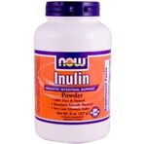
Human gut: management
Gastric health – inflammation, damage to gut, nutritional or dietary problems, protection from pathogens
Depends on interaction between host and microbial community
Prebiotics: indigestible food additives that stimulate growth of beneficial bacteria
e.g. inulin, fructo-oligosaccharides
increase Bifidobacterium populations
(more generally “fibre”)
Notes:
Role in digestion, protection from disease
How does complex system respond to change in conditions?
Fascinating system, currently descriptive and speculation

Slide 19
Human gut: management
Probiotics: living organisms taken to alter host community with intended health benefit
Lactobacillus and Bifidobacterium treatments ameliorated diarrhea and irritable bowel syndrome
Could modulate host immune system, compete with detrimental species (for resources or exclude from epithelium walls), produce toxins
How can they invade complex community?
How predict consequences?
Notes:
Role in digestion, protection from disease
How does complex system respond to change in conditions?
Fascinating system, currently descriptive and speculation

Slide 20
Human gut: evolution
Potential for evolution and co-evolutionary interactions:
productive environment with high turnover
But also for colonisation of pre-adapted bacteria
How important is evolution for dynamics and function of gut communities?
Longer-term coevolution with host: gut biota is inherited from mother, potential for selection at higher levels
Notes:
Role in digestion, protection from disease
How does complex system respond to change in conditions?
Fascinating system, currently descriptive and speculation

Slide 21
With a change in diet, how does the gut microbiota respond?
Ecological and evolutionary responses
How predict and interpret dynamics?

Slide 22
Mathematical model to predict species interactions, evolution and functioning in microbial decomposer communities
Bacterial species metabolizing C-sources
Simplify: no phage, feedbacks, space…
Species 1, 2, 3
Input resources
Metabolic
products
Metabolic pathway,
Substrates S1, S2, etc
Host functions

Slide 23
Model growth of species on multiple substrates
Substrate 1
Substrate 2
Species 1
E1
E2
Notes:
Role in digestion, protection from disease
How does complex system respond to change in conditions?
Fascinating system, currently descriptive and speculation

Slide 24
1) Resource use specified by enzyme allocation
Substrate 1
Substrate 2
Species 1
E1
E2
Notes:
Role in digestion, protection from disease
How does complex system respond to change in conditions?
Fascinating system, currently descriptive and speculation

Slide 25
2) Species interactions determined by pattern of resource use
Species 1
Competition
Substrate 1
Substrate 2
Species 2
Species 1
Substrate 1
No interaction
Species 2
Substrate 2
Species 1
Species 2
Facilitation (cross-feeding)
Substrate 1
Substrate 2
Notes:
Role in digestion, protection from disease
How does complex system respond to change in conditions?
Fascinating system, currently descriptive and speculation

Slide 26
Case study: human gut:
Anaerobic fermentation of indigestible macromolecules into short-chain fatty acids
Notes:
Role in digestion, protection from disease
How does complex system respond to change in conditions?
Fascinating system, currently descriptive and speculation

Slide 27
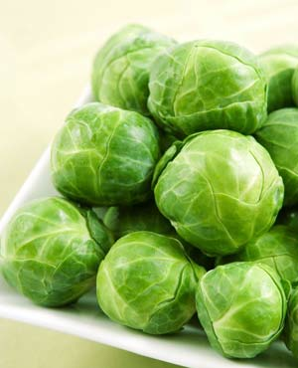
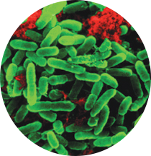
Case study: human gut:
Anaerobic fermentation of indigestible macromolecules into short-chain fatty acids
+ = Short Chain
Fatty Acids (SFCA)
Notes:
Role in digestion, protection from disease
How does complex system respond to change in conditions?
Fascinating system, currently descriptive and speculation

Slide 28
Can solve steady-state for specialists

Slide 29
Can solve steady-state for specialists

Slide 30
Metrics of functioning:
Low concentration of input S (e.g. decomposition/detoxification)
High biomass (e.g. biofuels)
High conc of intermediate substrate (e.g. SCFA in gut)
High conc of end product (e.g. gas biofuel)
Particular target ratio of substrates (e.g. balanced SCFA ratios)
Total of a set of substances (e.g. total SCFA production)
Can simulate for generalists, serial transfer

Slide 32
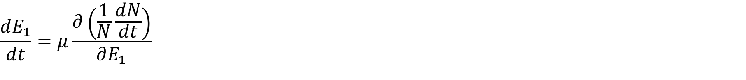
Add in evolution: allocation E1:E2 can evolve (sums to 1)
Substrate 1
Substrate 2
Species 1
E1
E2
Notes:
Role in digestion, protection from disease
How does complex system respond to change in conditions?
Fascinating system, currently descriptive and speculation

Slide 33
Consequences of evolution depend on trade-off

Slide 34
Eco-generalist
Evo-generalist
Evo-specialist
Conc.

Slide 35
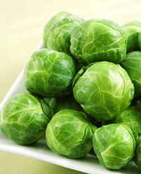
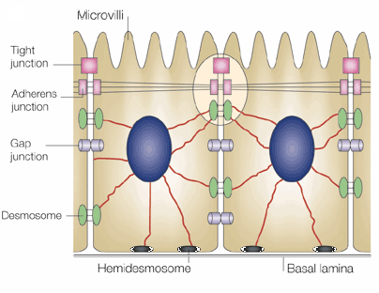
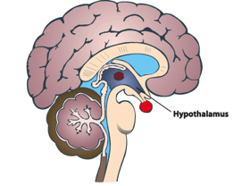
Top down: perturbing human gut microbiota
+ = Short Chain
Fatty Acids (SFCA)
SCFA + = PPY + GLP1 (anoretic gut hormones)
PPY + = reduced appetite
Gemma Walton, Jonathan Swann, Glenn Gibson, Univ. Reading
Laura Johnson, Gary Frost, Arianna Psichas, Imperial College London
Notes:
Role in digestion, protection from disease
How does complex system respond to change in conditions?
Fascinating system, currently descriptive and speculation

Slide 36

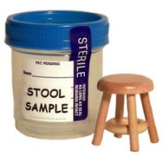
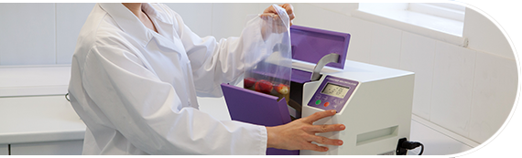
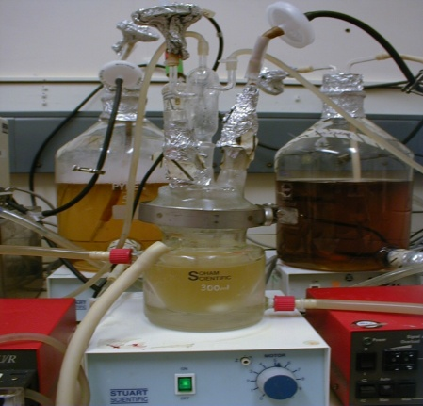
3 healthy volunteers (no recent history of antibiotic/probiotic use)
3 stool samples collected. Stools were weighed and diluted roughly 1:5 with PBS
Diluted stools were homogenised using a Stomacher 400
Faecal slurries were added to vessels containing 100 ml nutrient rich gut model media. This was left for two weeks for bacteria to acclimatise and chemostats to reach a steady state.
Notes:
Look up ingredients of media – may be asked. Fix this slide – needs to look better, get rid of DC.

Slide 37
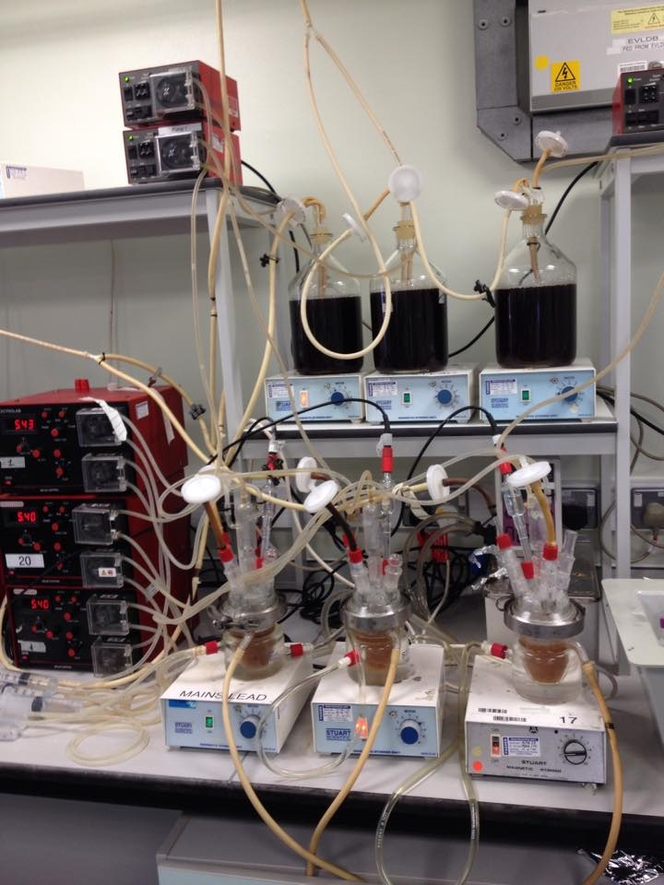
Flow rate – 6.25 ml/h
Basal nutrient media supplemented with inulin
Water bath – 37. C
Chemostats
Vol 1
Vol 2
pH controllers – pH 5.4 – 5.6
Vol 3
Notes:
After two weeks, media was switched to a more basic nutrient recipe, with inulin as the main carbon source. (Equivalent to amount consumed each day). Fix this – arrows and boxes look awful.

Slide 38
mixed
inulin
Taxa
Log(f)
Diversity
Notes:
After two weeks, media was switched to a more basic nutrient recipe, with inulin as the main carbon source. (Equivalent to amount consumed each day). Fix this – arrows and boxes look awful.

Slide 39
mixed
inulin
Taxa
Log(f)
metabolites
Notes:
After two weeks, media was switched to a more basic nutrient recipe, with inulin as the main carbon source. (Equivalent to amount consumed each day). Fix this – arrows and boxes look awful.

Slide 40
Communities re-isolated from volunteers produce higher acetate,
butyrate, propionate on all diets.
Evolved inulin community produces more lactate, glucose, i4a.
Re-isolated
Chemostat
cultures
’evolved in vitro’
Notes:
After two weeks, media was switched to a more basic nutrient recipe, with inulin as the main carbon source. (Equivalent to amount consumed each day). Fix this – arrows and boxes look awful.

Slide 41
Evolution or just ecological sorting?
Notes:
After two weeks, media was switched to a more basic nutrient recipe, with inulin as the main carbon source. (Equivalent to amount consumed each day). Fix this – arrows and boxes look awful.

Slide 42
Approaches:
a) Bottom-up
Construct simplified communities, manipulate conditions, track evolution: species interactions & functioning evolves
b) Top down
Culture whole gut communities in vitro, manipulate conditions, track responses: new methods to track mechanisms
c) Mathematical models
Generate predictions for expected evolution of resource use, species interactions and functioning: bacterial metabolism

Slide 43
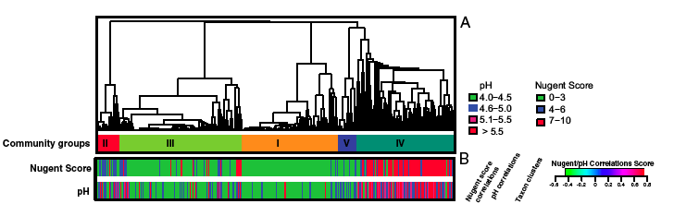
Many other similar systems of interest
5 classes of community in vaginal microbiome
4 dominated by different Lactobacillus species (keystone species)
Major difference in pH (much higher) in fifth class => consequences for fertility, protection from pathogens
Significant differences among racial groups
Notes:
Role in digestion, protection from disease
How does complex system respond to change in conditions?
Fascinating system, currently descriptive and speculation

Slide 44
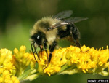
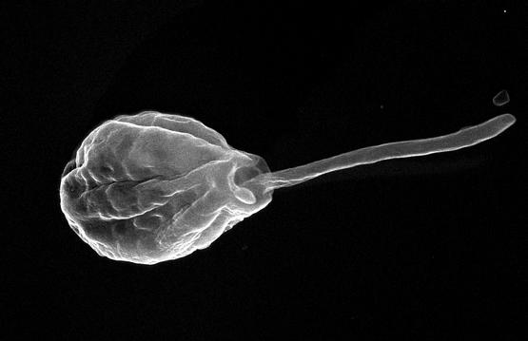
Insect gut microbiota
…protection from disease
Koch H. & Schmid-Hempel 2011. PNAS
Honeybees and
Crithidia bombi

Slide 45
Evolution in gut virome
Track changes in SNPs over time
And use CRISPR sequence
To infer host and coevolution
Minot et al. 2013.
PNAS. 110:12450

